Slide 1
Early work on a compiler flow for emerging variable precision formats

Slide 2
FP Representation
Many applications use floating point numbers
Execution time and energy spent in floating point operations is significant
Precision
  Why is it important?
    The programmer must decide which precision to use
  Overkill (too much precision)
    Waste performance and energy
    CNNs, and low-precision GPU algorithms may require <8-bit of precision ^{[1,2]}
  Insufficient (too little precision)
    Cancellation^{[3, 4]}:
      Two nearby quantities are subtracted and the most significant digits cancel each other (e.g. (1.5 + 1.0e26) – 1.0e26 = 0 in IEEE 32-bit and 64-bit)
    Rounding^{[4]}:
      Limited number of bits (e.g. IEEE 32-bit represents 16,777,217.0 as 16,777,216.0)
[1] M. Amiri, et. al. “Multi-Precision Convolutional Neural Networks on Heterogeneous Hardware”. In: DATE 2018
[2] H. Alemdar, et. al. “Ternary neural networks for resource-efficient AI applications”. In: IJCNN 2017.
[3] D. Defour, FP-ANR: A representation format to handle floating-point cancellation at run-time. 2017.
[4] J.M. Muller, et al. "Handbook of floating-point arithmetic." (2010): 62.
Notes:
Representing numbers in floating-point format have been explored for many decades. People who design systems are always focused on performance and energy efficient systems. And very often, programmers take for granted the precision used for representing floating numbers. Main issues of choosing precision are overkill or insufficient representation.

Slide 3
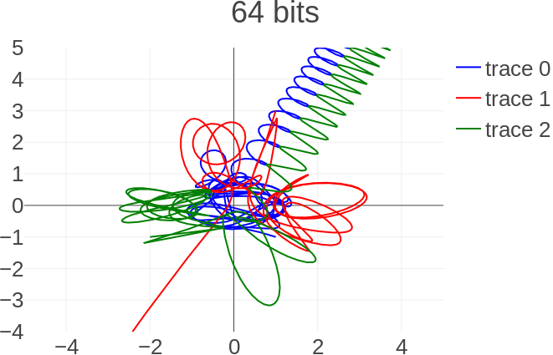
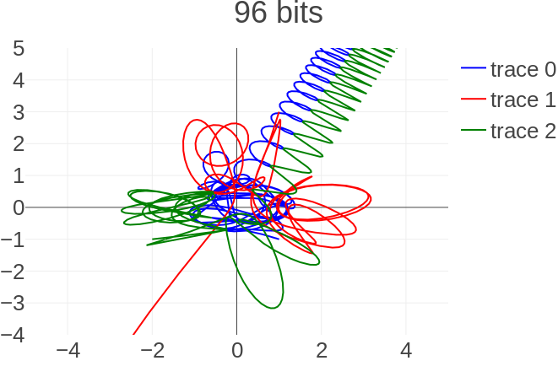
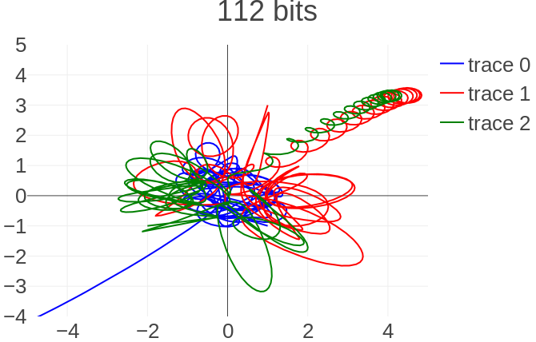
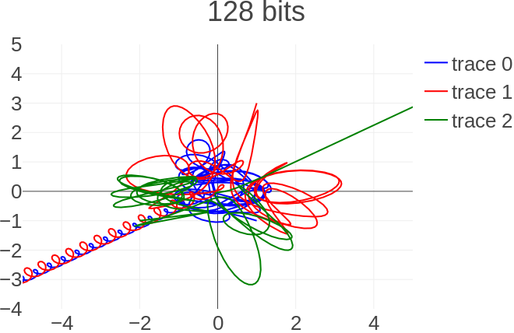
FP Representation
Three body problem^{[3]} calculates the position, velocity and acceleration of three particles over time
> IEEE 64-bit
IEEE 64-bit <
< IEEE 128-bit
≈ IEEE 128-bit
> IEEE 128-bit
[5] C. Marchal, The three-body problem. Elsevier, 2012.

Slide 4
FP Representation
Three body problem^{[3]} calculates the position, velocity and acceleration of three particles over time
> IEEE 64-bit
IEEE 64-bit <
< IEEE 128-bit
≈ IEEE 128-bit
> IEEE 128-bit
[5] C. Marchal, The three-body problem. Elsevier, 2012.

Slide 5
IEEE Format
IEEE defines 16, 32, 64 and recently 128-bit representation^{[4]}
  Fixed size format
  May suffer for the aforementioned issues (overkill, cancelation and rounding)
Possible solution: a different representation that has variable precision
5 bit (IEEE 16-bit)
8 bit (IEEE 32-bit)
11 bit (IEEE 64-bit)
15 bit (IEEE 128-bit)
10 bit (IEEE 16-bit)
23 bit (IEEE 32-bit)
52 bit (IEEE 64-bit)
112 bit (IEEE 128-bit)
1 bit
s | e | m
sign | exponent | mantissa
[6] Zuras, Dan, et al. "IEEE standard for floating-point arithmetic." IEEE Std 754-2008 (2008): 1-70.

Slide 6
Variable precision FORMAT
In 2015, John Gustafson proposed Universal NUMber^{[5]}, or UNUM, a variable precision (VP) format for FP numbers.
  Sign, Exponent and Fraction fields just like IEEE Format
  “Metadata” fields for self-description of exponent and fraction sizes
  Ubit
    FP number (0) or an open interval (1)
In 2017, John Gustafson proposed Posit
  With fixed size but variable exponent and mantissa
Like IEEE Format
Metadata info
 | es bits | fs bits
s | e | f | u | es-1 | fs-1
sign | exponent | fraction | ubit | exponent size | fraction size
[7] John L. Gustafson, “The End of Error - Unum Computing”, CRC Press, 2015.
[8] JL Gustafson,., & I. Yonemoto. Beating floating point at its own game Posit arithmetic. Supercomputing Frontiers and Innovations, 4(2), 71–86

Slide 7
Variable precision FORMATs
High-level UNUM/Posit Implementation
  Julia
  Python
  C++ libraries
UNUM/Posit hardware
  Bocco (2017)^{[7]} , Glaser (2018)^{[8]}, Jaiswal (2018)^{[9]}
Research challenge
  Who/what does the interface between HL languages
  and hardware for variable precision?
  What is the compiler role on variable precision?
Compilation flow for variable precision formats
High-level Var Prec Software (libraries, types, etc.)
?
Var Prec Hardware
(Co-processors or ALUs)
[9] A. Bocco, et. al. “Hardware support for UNUM floating point arithmetic”. In: PRIME. IEEE. 2017, pp. 93–96
[10] F. Glaser et al. “An 826 MOPS, 210uW/MHz Unum ALU in 65 nm”. In: 2018 IEEE ISCAS. May 2018, pp. 1–5.
[11] M. K. Jaiswal, & H. K. So, Universal number posit arithmetic generator on FPGA. In DATE, 2018 (pp. 1159-1162)

Slide 8
Agenda
State of the art
  FP representation
  IEEE format
    Characteristics and limitations
  Variable precision formats
    Characteristics
This work
  Compilation flow
    Overview
    Compiler-hardware integration
Future perspectives

Slide 9
Agenda
State of the art
  FP representation
  IEEE format
    Characteristics and limitations
  Variable precision formats
    Characteristics
This work
  Compilation flow
    Overview
    Compiler-hardware integration
Future perspectives

Slide 10
Compilation flow Overview
Investigation of applications for var. prec characteristics
  Domains:
    Scientific computing
    Computational geometry
  Ex.: Three-body problem, Cholesky, SparseSolve, Jacobi
Application
How programmers express code for variable precision?
  We propose a new data type in C: vpfloat
  vpfloat is a primitive type like int and double
Language Specification
Explore novel compiler optimizations for variable precision computing
Code generation to the processor and memory
  Single core systems
  Multi-core systems
Compiler and Libraries
Hardware
Memory
Processor
Variable precision-capable hardware
Notes:
We can divide part of the work on Variable precision in to layers.

Slide 11
Compilation flow Overview
Application
Language Specification
Compiler and Libraries
This work
Hardware
Memory
Processor
Notes:
We can divide part of the work on Variable precision in to layers.

Slide 12
Compilation flow overview
Software floating support for the vpfloat
Applications for var. prec.
Compilation Flow
UNUM HW by Bocco^{[9]} or other HWs for VP

Slide 13
Compilation flow overview
Software floating support for the vpfloat
Applications for var. prec.
Compilation Flow
UNUM HW by Bocco^{[9]} or other HWs for VP

Slide 14
Software floating point support
Goals
  Emulate vpfloat entirely in software (when no HW for VP is provided)
  Provide a testing infra for different formats
Where we are
  Evaluating the effectiveness and programmability of the approach in comparison to manual solutions
vpfloat
struct vp_float {
char number[bytes];
}
UNUM Library
Applications written with vpfloat
LLVM^{[10]} Transformation Pass
Posit Library
vpfloat(16, 256) a[10000];
vpfloat(16, 256) b[10000];
vpfloat(16, 256) c = b[0];
for (i = 1; i< 10000; ++i) {
a[i] = i;
b[i] = a[i] + c;
c = b[i];
}
Any FP format Lib.
[10] C. Lattner, and V. Adve. LLVM: A compilation framework for lifelong program analysis & transformation. In CGO 2004 p. 75.

Slide 15
Software floating point support
MPFR
  Library for arbitrary-precision floating-point computation
  Programming model requires the user to allocate and free the MPFR objects, i.e., it is prone to memory leakage
LLVM IR Pass that converts vpfloat to MPFR calls
  Handles allocs and frees
  Better programming model (just like writing int and float)
abs example through MPFR
abs example through vpfloat
void abs(mpfr_t *v1, mpfr_t *v2, unsigned size, mpfr_t *dst) {
mpfr_t tmp; mpfr_init2(tmp, prec);
for (unsigned i = 0; i < size; ++i) {
mpfr_sub(tmp, v1[i], v2[i], roundingMode);
mpfr_abs(dst[i], tmp, roundingMode);
}
mpfr_clear(tmp);
}
void abs(vpfloat *v1, vpfloat *v2, unsigned size, vpfloat *dst) {
for (unsigned i = 0; i < size; ++i) {
dst[i] = absv(v1[i] - v2[i]);
}
}

Slide 16
Software floating point support
Preliminary experiments
  Same application, same MPFR, different programming model
    Soft conversion, VPFloat Class and Boost are similar
  Boost library used as baseline
  Soft conversion gets closer to MPFR than other solutions
    Improvements: minimize number of allocs
Application |  | MPFR | MPFR Naive | Soft Conversion | VPFloat Class | Boost
3-body problem | Time (s) | 2,6 | 2,7 | 4,3 | 6 | 11,0
 | Speedup | 4,23 | 4,07 | 2,56 | 1,83 | 1,00
 | Num. of Mallocs | ~17M | ~23M | ~39M | ~97M | N/A

Slide 17
Compilation flow overview
Software floating support for the vpfloat
Applications for Var Prec
Compilation Flow
UNUM HW by Bocco^{[9]} or other HWs for VP

Slide 18
Compilation flow overview
Software floating support for the vpfloat
Applications for Var Prec
Compilation Flow
UNUM HW by Bocco^{[9]} or other HWs for VP

Slide 19
Compiler-hardware integration (Code generation)
RISC-V^{[11]}, open-source ISA
ISA extension for variable precision operations
LLVM^{[10]}, a compiler framework, supports the ISA extension for VP
$
L1
$
L1
RAM
RISC-V
FPU
RAM
L&S
Var Prec
co-proc
L&S
Scratchpad
[11] “RISC-V Foundation - Instruction Set Architecture (ISA)”. In: URL : https://riscv.org.
[10] C. Lattner, and V. Adve. LLVM: A compilation framework for lifelong program analysis & transformation. In CGO 2004 p. 75.

Slide 20
Compiler-hardware integration
Register File with 32 Registers with eight 64-bit chunks
Main challenges
  Managing precision in runtime
    An integration between language and hardware-related features
  Number of live variables is larger than register file entries
    Stack spilling/filling of data with different sizes
Where we are
  Ready to start evaluation when the HW is ready
float a_f[10000];
unsigned precision = 128;
while (tol > tolerance) {
vpfloat(15, ++precision) b_vp[10000];
for (unsigned i = 1; i< 10000; ++i) {
b_vp[i] += SomeFunc();
}
tol = calcTolerance();
}
Scratchpad
f
e
L
f
e
L
m0
m0
m1
m1
m2
m2
m3
m3
DW
DW
f
e
L
f
e
L
m0
m0
m1
m1
m2
m2
m3
m3
DW
DW

Slide 21
Agenda
State of the art
  FP representation
  IEEE format
    Characteristics and limitations
  Variable precision formats
    Characteristics
This work
  Compilation flow
    Overview
    Compiler-hardware integration
Future perspectives

Slide 22
Agenda
State of the art
  FP representation
  IEEE format
    Characteristics and limitations
  Variable precision formats
    Characteristics
This work
  Compilation flow
    Overview
    Compiler-hardware integration
Future perspectives

Slide 23
Future perspectives
We envision a full-stack platform for VP Computing:
  Software (compiler, libraries, etc.):
    Main focus of the thesis
  Multi-core processor with VP co-processors for scientific computing applications

Slide 24
REFERENCES
[1] M. Amiri, et. al. “Multi-Precision Convolutional Neural Networks on Heterogeneous Hardware”. In: DATE 2018
[2] H. Alemdar, et. al. “Ternary neural networks for resource-efficient AI applications”. In: IJCNN 2017.
[3] D. Defour, FP-ANR: A representation format to handle floating-point cancellation at run-time. 2017.
[4] J.M. Muller, et al. "Handbook of floating-point arithmetic." (2010): 62.
[5] C. Marchal, The three-body problem. Elsevier, 2012.
[6] Zuras, Dan, et al. "IEEE standard for floating-point arithmetic." IEEE Std 754-2008 (2008): 1-70.
[7] J. Gustafson, “The End of Error - Unum Computing”, CRC Press, 2015.
[8] J. Gustafson,., & I. Yonemoto. Beating floating point at its own game Posit arithmetic. Supercomputing Frontiers and Innovations, 4(2), 71–86
[9] A. Bocco, et. al. “Hardware support for UNUM floating point arithmetic”. In: PRIME. IEEE. 2017, pp. 93–96
[10] F. Glaser et al. “An 826 MOPS, 210uW/MHz Unum ALU in 65 nm”. In: 2018 IEEE ISCAS. May 2018, pp. 1–5.
[11] M. K. Jaiswal, & H. K. So, Universal number posit arithmetic generator on FPGA. In DATE, 2018 (pp. 1159-1162
[12] C. Lattner, and V. Adve. LLVM: A compilation framework for lifelong program analysis & transformation. In CGO 2004 p. 75.
[13] “RISC-V Foundation - Instruction Set Architecture (ISA)”. In: URL : https://riscv.org.

Slide 25
Merci beaucoup!
Thank you!
Email: tiago.trevisanjost@cea.fr

